Slide 1
Do preferences for exceptions to the rule vary by context?
Kristen McGatlin and Dr. Tyler Davis

Slide 2
Why do we like what we like?
While there is more that goes into liking something
Subjectivity
Cognitive processes?
Notes:
Why do we like the things that we like? Important area of social and cognitive research, relevant in an applied sense
Need less restoration due to liking, less cognitive fatigue?
People continue using systems they prefer
Human computer interaction, people liking the interfaces

Slide 3
Applied Importance?
Work performance: preferred environment may cause less cognitive strain/stress = higher productivity
Marketing: gravitate towards systems/products they like
Equate preference with choice/decision making

Slide 4
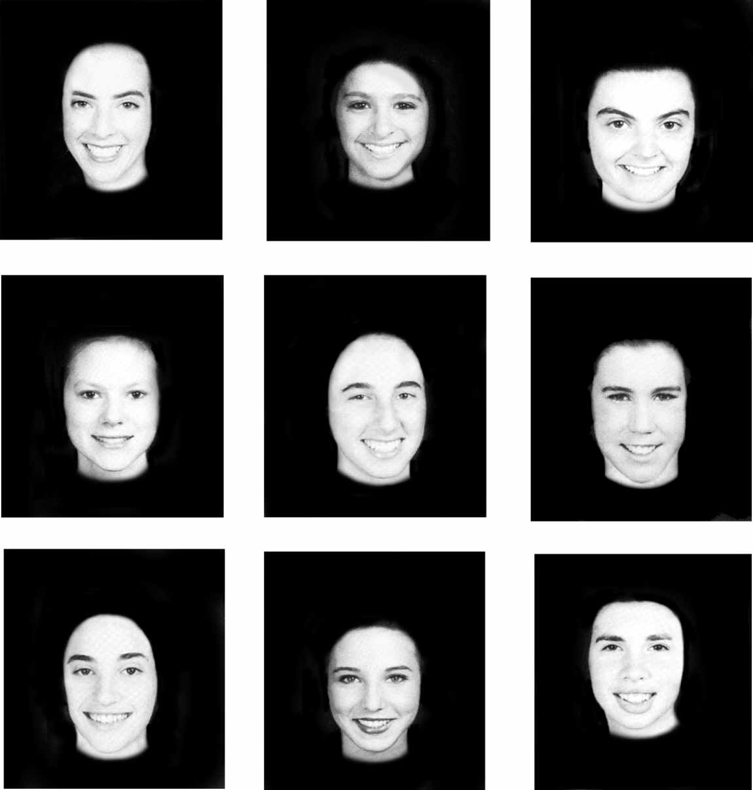
Competing theories: Familiarity
Exp. 1: Familiarity rating, distinctiveness rating, attractiveness rating
Familiarity and distinctiveness negatively correlated
Familiarity positively correlated with attractiveness
Exp. 2: showed faces 6 times, then judgment phase
Previously seen photos rated as more attractive
Peskin & Newell, 2004

Slide 5
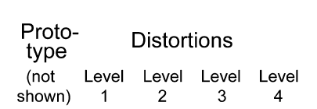
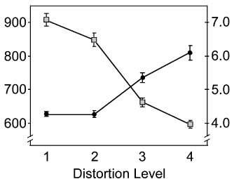
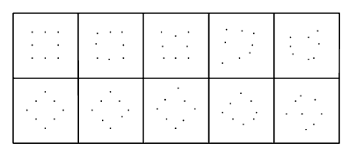
Competing Theories: Fluency
Winkielman et al., 2006.

Slide 6
Problem
Separating the two into actually separate ideas
Fluency correlated with familiarity

Slide 7
Solution: Exceptions to the rule
Exceptions to category rules are more familiar and fluent depending on context, therefore able to disentangle the theories (Davis, Love, Preston, 2012)

Slide 8
Purpose
Replicate previous research on learning categories
Rule following items are categorized more accurately than exceptions
Exceptions are recognized more accurately than rule following items
Extend previous research
Preference of the exceptions vs. rule following items

Slide 9
Question
Will participants base their preferences of the exception items on…
Fluency: exception preference determined by context
Familiarity: exceptions always preferred

Slide 10
Hypotheses: Fluency
Participants will prefer exceptions more during recognition tests than the rule following items, and vice versa during the test phase.
Participants will be better at recognizing but worse at classifying the exceptions.

Slide 11
Method
2 (stimuli type: fribble vs. squares) x 2 (phase order: categorization> recognition vs. recognition> categorization)
Measuring
Preference rating
Categorization scores
Recognition scores
Reaction times
N= 27
Mean age=24
13 Females, 14 Males

Slide 12
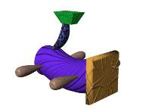
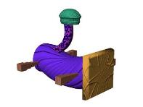
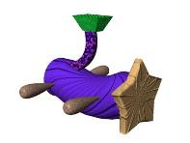
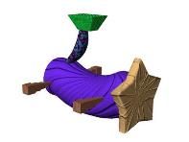
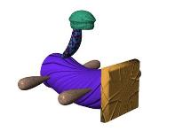
Stimuli
Category 1 Category 2

Slide 13
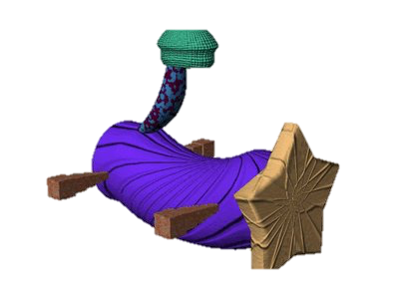
Procedure
Learning Phase
Category test/Preference Phase
Recognition/Preference Phase
Recognition/Preference Phase
Category test/Preference Phase
Recognition/Preference Phase
Category test/Preference Phase
Category test/Preference Phase
Recognition/Preference Phase

Slide 14
Learning/Test Phase

Slide 15
Recognition Phase

Slide 16
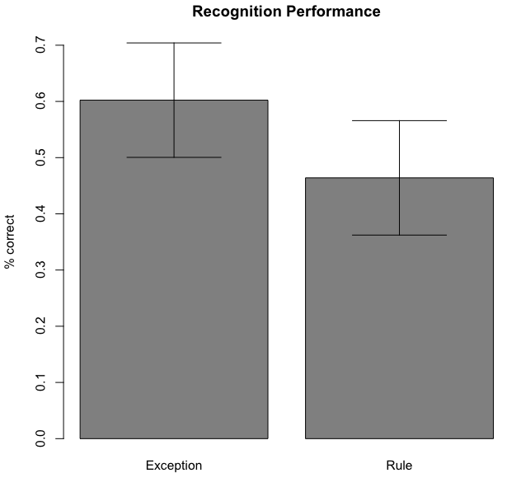
Recognition Performance

Slide 17
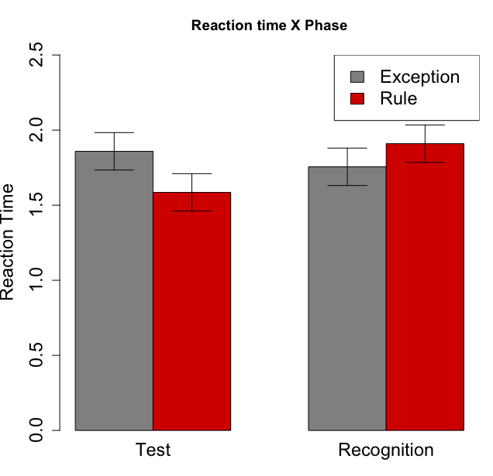
Reaction Time Interaction

Slide 18
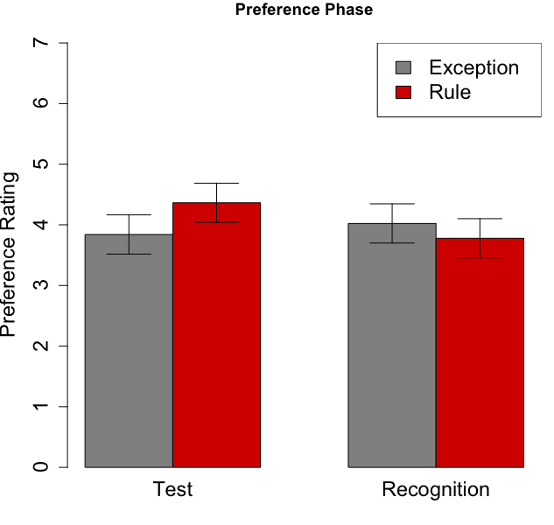
Preference Ratings Interaction

Slide 19
Discussion
What do we learn?
Preliminary research suggests fluency is process behind preference formation
Limitations:
Rule hard to learn – threw out 16 non-learners
For future research, the participants may be given the categorization dimension before beginning to ensure high learning rats with less exclusion

Slide 20
Conclusion
Exceptions found to be recognized faster and with greater accuracy than rule following items
Extended previous research and found that preferences may be formed as a result of processing fluency, rather than familiarity

Slide 21
References
Davis, T., Love, B., Preston, A. (2012). Striatal and hippocampal entropy and recognition signals in category learning: simultaneous processes revealed by model based MRI. Journal of Experimental Psychology: Learning, Memory, and Cognition, 38, 821-839
Peskin, M. & Newell, F. (2004). Familiarity breeds attraction: effects of exposure on the attractiveness of typical and distinctive faces. Perception, 33, 147-157
Winkielman, P., Halberstadt, J., Fazendeiro, T., & Catty, S. (2006). Prototypes are attractive because they are easy on the mind. Association for Psychological Science, 17, 799-806

Slide 22
ACKNOWLEDGNTS
This material is based upon work supported by the National Science Foundation under Grant No. 1559393

