Slide 1
Humanization of Robots: The Role of Group Membership
Presentation by Madeline Niichel

Slide 2
Purpose
Treatment of robots – sometimes like humans, sometimes not
Anthropomorphism: projecting human-like qualities onto an object
Assume inverse of dehumanization
Legal implications
How we protect animals vs. how we protect robots
Practical Implications
Knowledge about treatment of robots will help us design them to better suit needs of society
Current study: group effects and treatment of robots

Slide 3
Background
Two dimensions of anthrop.: Human Uniqueness and Human Nature (Haslam, 2006) – a.k.a. Haslam’s dual model scale
Human Uniqueness—separates humans from animals (civility, refinement, rationality, morality & maturity)
Human Nature—separates humans from machines (intuition, agency, spontaneity, cognitive openness & emotional responsiveness)
Group belonging—members of out-groups considered less human (Haslam & Loughnan, 2014)
Spurred current study

Slide 4
Background

Slide 5
Background
Häring, Kuchenbrandt, & André (2014)
Two robots—in-group and out-group cooperation/competition
Positive evaluation of in-group robot, anthrop. stronger
Eyssel & Kuchenbrandt (2012)
Two conditions—German or Turkish (in- and out-group)
In-group judged more favorably, and anthrop. stronger
Trovato et al. (2013)
Two robots introduced in Arabic and Japanese
Positive evaluation of in-group robot, anthrop. stronger
Notes:
There is evidence that they find group effects in human-robot interactions

Slide 6
Research Question / Hypotheses
Group effects in human-robot interaction?
Agent’s robot qualities affect its “humanness” along mechanistic (H.N.) dimension
Group membership affects mostly animalistic (H.U.) dimension
Based on assumption anthrop. is inverse of dehumanization
Group effects in context of our study?
Expect to replicate above results

Slide 7
Method
Condition
Player 1 | Player 3
TTU_student | TTU_student
TTU_student | TTU_student
TTU_student | UT_student
UT_student | TTU_student
TTU_student | TTU_robot
TTU_robot | TTU_student
TTU_student | UT_robot
UT_robot | TTU_student
2 x 2 Between-Subjects design
Participants
74 TTU students & staff, 51 Females, Mean Age: 23 years
Eight conditions
Students/robots from University of Texas/Texas Tech University
Always TTU student on one side
Randomly assigned to one of eight conditions
Set up Cyberball program to toss ball 30 times—10 of which go to human player (participant)

Slide 8
Method
Independent Variables
TTU vs. UT
Student vs. Robot
Dependent Variables
Measures of HU and HN
HN_{manipulation}-HN_{TTU student} = HN Difference Score
HU_{manipulation}-HU_{TTU student} = HU Difference Score
Individual Differences in Anthrop. Questionnaire (IDAQ)
Perceived Awareness of Research Hypothesis (PARH)
Ball passes

Slide 9
Method
Condition
Player 1 | Player 3
TTU_student | TTU_student
TTU_student | TTU_student
TTU_student | UT_student
UT_student | TTU_student
TTU_student | TTU_robot
TTU_robot | TTU_student
TTU_student | UT_robot
UT_robot | TTU_student
Testing
Informed consent and instructions
Initial questions regarding robots (IDAQ)
Likelihood to anthropomorphize
Participant plays Cyberball
Questions about other players, demographics & PARH
Debriefed and Dismissed

Slide 10
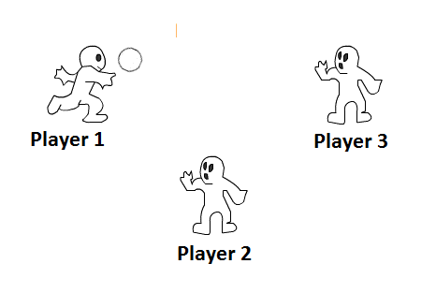
Method
Cyberball In Action

Slide 11
Expected Results
Results give insight into which dimensions are affected
Expectation that group membership (TTU vs. UT) affects mostly the Human Uniqueness dimension (animalistic)
Based on dehumanization research (Haslam & Loughnan, 2014)
Also expect that Student vs. Robot manipulation affects mostly the Human Nature dimension (mechanistic)

Slide 12
Results
Using SPSS and the Qualtrics data, descriptive tests were run
2 x 2 Between-Subjects Design, univariate ANOVA for each dependent variable
Manipulations did not appear to work as expected

Slide 14
Results
Significance found in Individual Differences in Anthrop. Questionnaire (IDAQ)
Mean differences in scores
In comparison to other TTU student
Unlike previous study, we found differences in IDAQ scores
Those in both robot and UT manipulations were more likely to anthropomorphize
May explain why we got the results we did

Slide 15
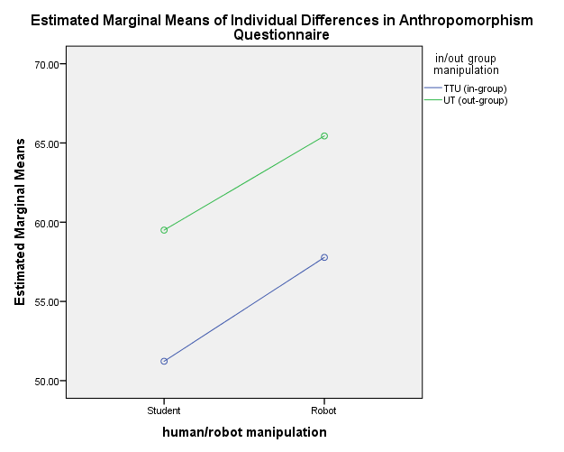

Slide 16
Conclusion
The data (to date) seems to suggest that there are minimal group effects
Participants in I.V. UT & robot group were predisposed to anthropomorphize more
See less of an effect when looking at H.U. and H.N. measures of anthropomorphism in D.V.
Randomization not sufficient
Need to control for individual differences in data analysis
Based on means, manipulations may have worked
Did not see differences in PARH scores, does not explain what happened with H.U. and H.N. scores

Slide 17
What Was Learned
Data collection & analysis is strenuous and tedious
Sometimes need to control for differences
Randomization was not sufficient
In future research—conduct some sort of matching procedure
Screen for IDAQ scores to account for this effect

Slide 18
Practical Importance
If the manipulations worked in this context: better able to leverage the literature about dehumanization
Predictions about how people may interact with robots
Apply current group effects literature to humanoid robots
Overall, interactions with humanoid or human-like robots are better understood
Assistive, healthcare or companion robots

Slide 19
References
Eyssel, F., & Kuchenbrandt, D. (2012). Social categorization of social robots: anthropomorphism as a function of group
membership. British Journal of Social Psychology, 51, 742-731. DOI: 10.1111/j.2044-8309.2011.02082.x.
Häring, M., Kuchenbrandt, D., & André, E. (2014). Proceedings of the 2014 ACM/IEEE international conference: Would
you like to play with me? How robots’ group membership and task features influence human-robot interaction. DOI: 10.1145/2559636.2559673
Haslam, N. & Loughnan, S. 2014. Dehumanization and Infrahumanization. Annual
Review of Psychology, 65, 399-423.
Haslam, N. 2006. Dehumanization: An Integrative Review. Personality and Social
Psychology Review, 10, 252-264.
Trovato, G., Zecca, M., Sessa, S., Jamone, L., Ham, J., Hashimoto, K., & Takanishi,
A. (2013). Cross-cultural study on human-robot greeting interaction: acceptance and discomfort by Egyptians and Japanese. PALADYN Journal of Behavioral Robotics, 4, 83-93. DOI: 10.2478/pjbr-2013-0006 JBR

Slide 20
Acknowledgements
Special thanks to Dr. Keith Jones and his Graduate student Miriam Armstrong for allowing me to help them with this study, and for being patient with me as I learned and grew throughout this process.
Also, thank you to Dr. Pat DeLucia and Dr. James Yang for organizing this REU program.
This material is based upon work supported by the National Science Foundation under Grant No. 1559393

