Slide 1


PERSPECTIVE TAKING AND RELATIONSHIP ADVICE
Auriel Jasper-Morris
Department of Psychology, Xavier University of Louisiana
Amelia Talley, Ph.D.
Department of Psychological Sciences, Texas Tech University

Slide 2
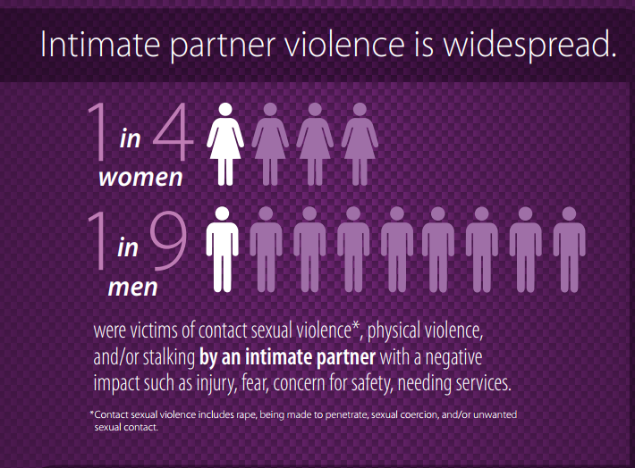
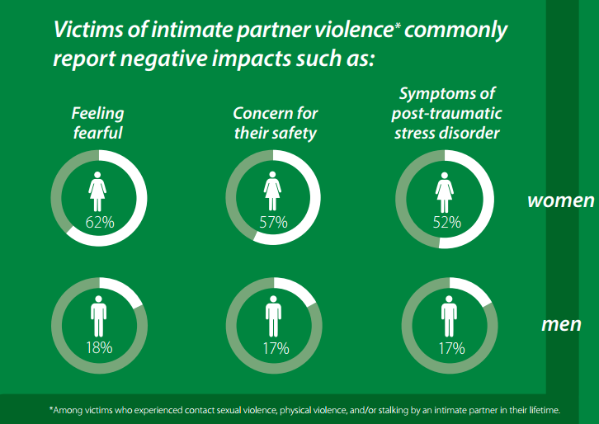
INTIMATE PARTNER VIOLENCE (IPV) STATISTICS
Show why should we care about this?
Maybe present statistics on how many are affected by domestic violence? or societal costs?
(Centers for Disease Control and Prevention [CDC], 2017)
Notes:
Intimate Partner Violence- The term “intimate partner violence” describes physical violence, sexual violence, stalking and psychological aggression (including coercive acts) by a current or former intimate partner.
Economic Effects
Intimate partner violence is estimated to cost the US economy between $5.8 billion and $12.6 billion annually, up to 0.125% of the national gross domestic product.

Slide 3
INTRODUCTION
Current research questions:
Does a friend’s advice to leave an abusive relationship change depending on factors of the abusive relationship?
Does knowing someone with a history of domestic abuse or having a history of domestic abuse change a person’s advice to leave an abusive relationship ?

Slide 4
INTRODUCTION
Egosystem and Ecosystem motivational orientations point to self-image and compassionate goals, respectively, as being key predictors to various physical and mental health outcomes (e.g., Crocker, 2008; Crocker, Olivier, & Nuer, 2009).
Ecosystem motivations (Compassionate goals)-Compassionate goals involve a focus on supporting others, not to obtain something for the self, but out of consideration for the well-being of others.
Egosystem motivations (Self-image goals)-When people have self-image goals, they want to construct, maintain, and defend desired public and private images of the self in order to gain or obtain something for the self.
(Crocker & Canevello, 2008)

Slide 5
PAST LITERATURE
The actions of male perpetrators are viewed more seriously and victims are recommended to seek more forms of assistance when the perpetrator is male (Dennison & Thompson, 2011).
Observers judge abusive behavior as more common and “less abusive” when alcohol is involved, but only for psychologically abusive behaviors and moderately severe physically abusive behaviors (Witte, Kopkin, & Hollis, 2015).
The presence of a child will activate a greater readiness to offer advice to leave a potentially abusive situation(Shepard, 1992).

Slide 6
HYPOTHESES
Evoking an ecosystem motivational perspective, as opposed to an egosystem motivational perspective, will increase an individual’s readiness to give advice to leave an abusive relationship.
Different factors inherent in an abusive relationship (e.g., gender of perpetrator, alcohol consumption, and/or presence of a child) will alter an individual’s readiness to give advice to leave the relationship.
Notes:
Hypothesis: Ecosystem motivations will activate greater readiness to offer advice to leave a potentially abusive situation.
There is a marginal effect, whereby eco-system goals do result in more readiness to give advice to leave a violent situation, F(1, 207) = 2.968, p = .086.
Ecosystem Sample: “I will try to have compassion for others.”
Egosystem Sample: “I want to try to present a positive image of myself.”
There is a significant main effect, suggesting that there is more willingness to offer advice to leave if there are no kids mentioned, F(1, 226) = 3.595, p = .059.

Slide 7
METHODS & PROCEDURES

Slide 8
PARTICIPANTS
N = 626 MTurk Workers
  316 Females
  294 Males
  16 Transgender/Non-Binary/Third-Gender
A majority of participants (58%) had been or knew someone that had been in an abusive relationship
Age Range: 19-79, M = 34.96, SD = 12.19
Ethnicity: 13% self-identified as Hispanic
Race demographics (Caucasian/White [70%], Asian [14%], African American/Black [9%], American Indian [3%], Biracial [4%]) respectively

Slide 9
DESIGN & PROCEDURES
2 (Motivational Perspective: Eco- vs. Ego-system Goal Activation) X 2 (Experimental Manipulation: highlighting task vs. goal-rating task) X 2 (Presence of alcohol) X 2 (Presence of a child) X 2 (Gender of perpetrator) Between-Subjects Factorial Design

Slide 10
MATERIALS
Highlighting Task
(egosystem [I, Me, My] vs. ecosystem [We, Us, Our])
Highlight
I go to the city often. My anticipation fills me as I see the skyscrapers come into view. I allow myself to explore every corner, never letting an attraction escape me. My voice fills the air and street. Isee all the sights, I window shop, and everywhere I go I see my reflection looking back at me in the glass of a hundred windows. At nightfall I linger, my time in the city almost over. When finally I must leave, I do so knowing that I will soon return. The city belongs to me.

Slide 11
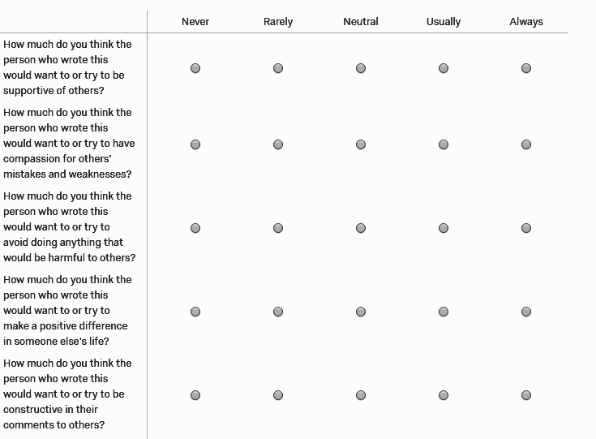
MATERIALS
Goal-Rating Task (8:2 Ratio)
Ecosystem Goal Sample: “I will try to have compassion for others.”
Egosystem Goal Sample: “I want to try to present a positive image of myself.”

Slide 12
MATERIALS
Vignettes factors
    Presence of alcohol
    Presence of a child
    Gender of Perpetrator

Slide 13
MATERIALS
Ready To Go Scale
38 items comprising four subscales derived from University of Rhode Island Change Assessment Scale
5-point Likert Scale, 1 “Strongly Disagree” to 5 “Strongly Agree”
Subscales: Precontemplation, Contemplation, Reversion, Maintenance
Score = (Contemplation+Reversion+Maintenance) – Precontemplation
  The higher the mean the greater readiness to give advice to leave an abusive relationship.
  (Jasper-Morris, Anderson, Vincent, & Potts, in preparation)
Notes:
Precontemplation: “Any issues in this relationship are not major.”
Contemplation: “My friend has a problematic relationship and he should work to change it.”
Reversion: “I believe Ken when he says that Jenny won't hurt him again.”
Maintenance: “My friend should seek help to prevent himself from having a relapse of this problem.”
from each subscale ?

Slide 14
ADDITIONAL VARIABLES
History of experience with IPV = “Have you, or someone you known ever been in an abusive relationship?”
  1 = Yes, 2= No
Ethnicity, racial, and gender status were adjusted for in all analyses.

Slide 15
RESULTS

Slide 16
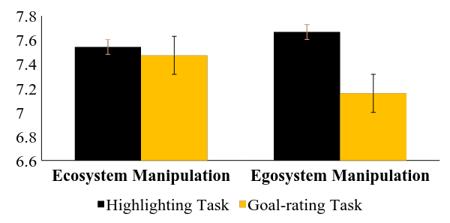
RESULTS
Hypothesis: Ecosystem motivations will activate a greater readiness to offer advice to leave a potentially abusive situation (Crocker & Canevello, 2008; Crocker, Canevello, & Lewis, 2016).
Results: Two-way interaction with experimental manipulation and eco- vs. ego-system activation, F(1,585) = 3.88, p < .05.
Readiness Mean

Slide 17
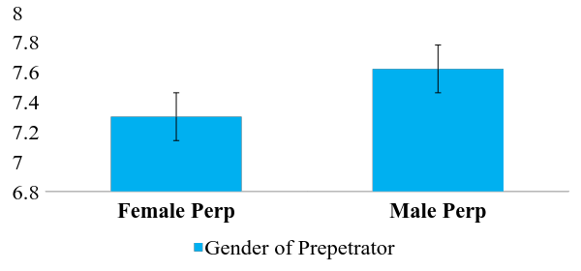
RESULTS
Hypothesis: A male perpetrator, compared to a female perpetrator, will activate a greater readiness to offer advice to leave a potentially abusive situation (Dennison & Thompson, 2011; Taylor & Sorenson, 2005).
Results: Results suggest that individuals are more willing to give advice to leave an abusive relationship when the perpetrator is male, F(1,585) = 9.07, p = .003.
Readiness Mean

Slide 18
INTERACTION RESULTS
There was a four-way interaction between motivational prime (i.e., eco vs ego goal-rating), experimental manipulation (highlighting task vs. goal-rating task), history of IPV, and whether alcohol was present in the home, F(1, 575) = 7.59, p = .006.
Notes:
Attempt to reconcile the opposing effect of condition. When participants were exposed to more compassionate goals, they were more willing to tell Ken to leave when Jenny was drinking. When participants were exposed to more self-image goals, they were more willing to tell Jenny to leave when Ken was drinking.

Slide 19
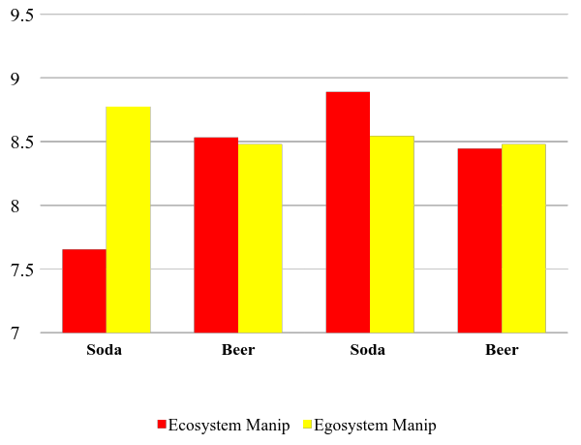
HIGHLIGHTING TASK
Readiness Mean
No Abuse History
Abuse History

Slide 20
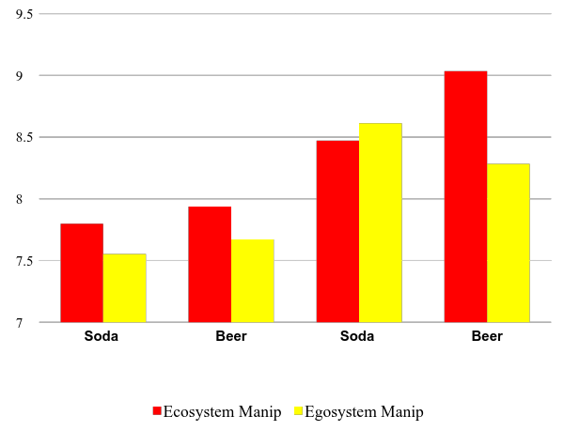
GOAL-RATING TASK
Readiness Mean
No Abuse History
Abuse History

Slide 21
DISCUSSION & CONCLUSION

Slide 22
DISCUSSION
Highlighting pronouns (I, me, my) in an egosystem motivational perspective, as opposed to highlighting pronouns ( we, us, our) in an ecosystem motivational perspective increases a friend’s willingness to give advice to leave an abusive relationship.
Rating goals in an ecosystem motivational perspective, as opposed to an egosystem motivational perspective increases a friend’s willingness to give advice to leave an abusive relationship.
Two-way interaction with experimental manipulation and eco- vs. ego-system activation, F(1,585) = 3.88, p < .05.
Notes:
Highlighting pronouns (I, me, my) in an egosystem motivational perspective increases a person’s readiness to give advice to leave an abusive relationship, as opposed to highlighting pronouns (We, us, our).
Rating goals in an ecosystem motivational perspective increases a person’s readiness to give advice to leave an abusive relationship, as opposed to rating goals in an egosystem motivational perspective.
Evoking an egosystem motivational perspective by highlighting pronouns (I, me, my), as opposed to an egosystem motivational perspective
Highlighting pronouns (I, me, my) in an egosystem motivational perspective, as opposed to highlighting pronouns ( we, us, our) in an ecosystem motivational perspective increases a friend’s willingness to give advice to leave an abusive relationship.
Rating goals in an ecosystem motivational perspective, as opposed to an egosystem motivational perspective increases a friend’s willingness to give advice to leave an abusive relationship.

Slide 23
DISCUSSION
The only significant main effect of the vignette factors suggested that there is more willingness to offer advice to leave if there was a male perpetrator mentioned in the vignette, F(1,585) = 9.07, p = .003.
Notes:
Highlighting pronouns (I, me, my) in an egosystem motivational perspective increases a person’s readiness to give advice to leave an abusive relationship, as opposed to highlighting pronouns (We, us, our).
Rating goals in an ecosystem motivational perspective increases a person’s readiness to give advice to leave an abusive relationship, as opposed to rating goals in an egosystem motivational perspective.
Evoking an egosystem motivational perspective by highlighting pronouns (I, me, my), as opposed to an egosystem motivational perspective
Highlighting pronouns (I, me, my) in an egosystem motivational perspective, as opposed to highlighting pronouns ( we, us, our) in an ecosystem motivational perspective increases a friend’s willingness to give advice to leave an abusive relationship.
Rating goals in an ecosystem motivational perspective, as opposed to an egosystem motivational perspective increases a friend’s willingness to give advice to leave an abusive relationship.

Slide 24
PRACTICAL IMPLICATIONS
Changes in perspective-taking can bolster one’s willingness to intervene in interpersonal issues and aid in adaptive behavior change
Use in educational programs
Notes:
Use in educational programs to inform others about the gap in literature, also show them how it’s this gap in protection of male and females that are involved in IPV situations. A person is less likely to intervene if the male is getting abused.

Slide 25
FUTURE DIRECTIONS
Participant characteristics may give further insight into advice-giving and what aspects of the person offering advice might matter.
Recent history of self-perpetrating violence
Recent history of partner-perpetrating violence
Personality traits (e.g., Conscientiousness; Neuroticism)
Demographics (e.g., personal income contribution)

Slide 26

ACKNOWLEDGMENTS
Thank you to the REU program
Mentor: Amelia Talley
Graduate Students: David Hancock & Tran Le

Slide 27
THANK YOU!
Questions?

Slide 28
EXTRA SLIDES
To bust out in case of emergency:

Slide 29
PURPOSE
The objective of the current research is to test whether a friend’s advice to leave a potentially abusive relationship is different depending on their motivational perspective.
We also sought to examine which aspects of an abusive relationship might alter advice that is given under various motivational perspectives.
Notes:
Amelia: Please use a font size of AT LEAST 24 point in all slides. This will ensure those with “bad eyes” or at the back of the room can read your slides.

Slide 30
MATERIALS
Conflict Tactic Scale-2 Short Form
40 questions
8-point Likert-type scale: 1 “Once in the past year” to 6 “More Than 20 times in the past year” 7 “Not in the past year, but it did happen before” 8 “This has never happened”
Subscales: Negotiation, Psychological Aggression, Physical Assault, Sexual Coercion, and Injury
  Categories: Minor and Major types of Assault
Physical Assault Samples: “I punched or kicked or beat-up my partner.” and “My partner punched or kicked or beat-me-up.”
The higher the reports of major abuse, the higher the severity level.
(Straus, 2004)

Slide 31
MATERIALS
BIDR Version 6- Form 40A (Paulhus, 1991)
40 questions; 20 reverse-scored items
7-point Likert-type scale: 1 “Not true” to 7 “Very true”
  one point added to sum score for every ‘6’ or ‘7’
Subscales:
  Impression Management (IM)
    High levels of IM convey that a person’s traits are inflated for the mere purpose of deceiving others but to try to align beliefs about oneself.
    Example IM item: “I never swear.”
  Self Deceptive Enhancement (SDE)
    High levels of SDE imply that a person is lying with the intent to deceive.
    Example SDE item: “I always now why I like things.”
Notes:
look into SDE results

Slide 32
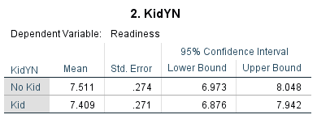
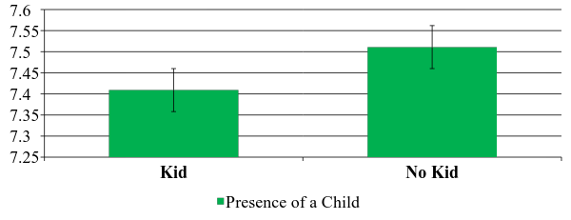
RESULTS
Hypothesis: The presence of a child will activate a greater readiness to offer advice to leave a potentially abusive situation (Shepard, 1992).
Results: No main effect of presence of a child, F(1, 585) =0.92, p = .34.
Readiness Mean

Slide 33
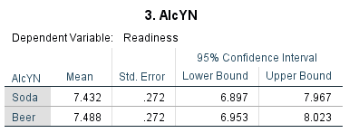
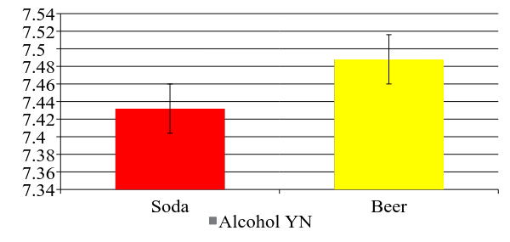
RESULTS
Hypothesis: The absence of alcohol will activate a greater readiness to offer advice to leave a potentially abusive situation (Witte, Kopkin, & Hollis, 2015).
Results: No main effect of presence of alcohol, F(1, 585) = 0.28, p = .60.
Readiness Mean

Slide 34
HIGHLIGHTING TASK
Readiness Mean
No Abuse History
Abuse History
Notes:
IF NEED TIME – CONSIDER CUTTING THE RESULTS FOR “NO ABUSE HISTORY” AND PUTTING THEM IN THE EMERGENCY SLIDE SECTION.

Slide 35
GOAL-RATING TASK
Readiness Mean
No Abuse History
Abuse History

Slide 36
LIMITATIONS
Goals were randomly presented in the experimental manipulation but order effects could still be relevant for general procedure.
Not representative of the United States population
Notes:
Any other limitation you can think of?

Slide 37
ACKNOWLEDGMENTS
This material is based upon work supported by the National Science Foundation under Grant No. 1559393

